Slide 1
Black History: African Empires
Student Health & Human Services Office of Human Relations, Diversity & Equity
June 2022
Notes:
Dear teacher, thank you for choosing to share this Advisory Lesson with your class. The Office of Human Relations, Diversity & Equity wants to remind all educators of the importance of teaching Black History all year long. February is a month to celebrate, amplify and recognize Black history. But students must understand that Black history is world history, and should be taught as such.

Slide 2
Welcome Do you prefer:
Showers
Baths
Notes:
Please invite the students to engage in the check in question.

Slide 3
Objectives
Learn about African Empires throughout history.
Review these rich, dynamic, and complex civilizations.
Reflect on the lack of these stories in public school history lessons.
Notes:
Please read the slides aloud for the students – remind students of classroom norms.

Slide 4
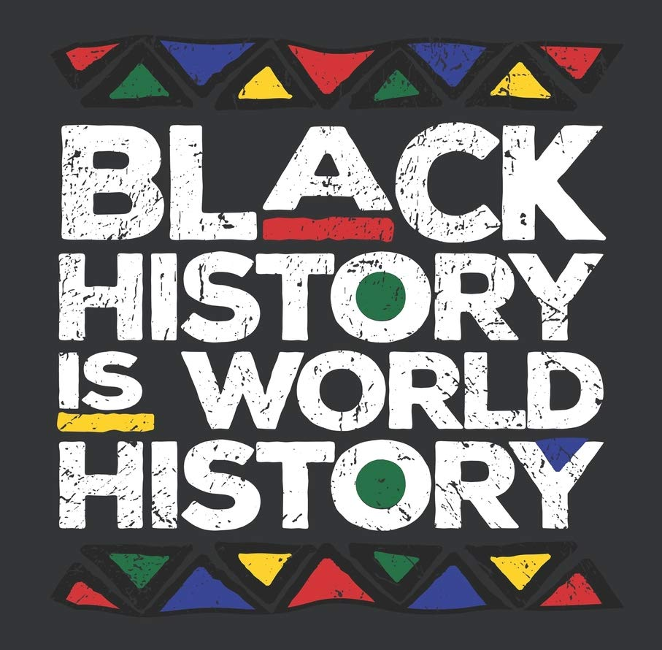
Black History Predates Enslavement
Modern history tells us that the enslavement of African peoples began in the 15th century.
However, it is critical that students worldwide understand that this is not where Black history begins.
Black people in Africa, and around the globe, have a long, rich and dynamic history that begins far before the enslavement of Black people.
Notes:
Please read the slide aloud for the students.

Slide 5
Reflection
Based on your education so far, what great African empires or kingdoms do you know of?
Notes:
Please invite the students to engaeg in the check in question.

Slide 6
African Kingdoms
Notes:
https://www.youtube.com/watch?v=Akca0mUW2K0
Play video for the students (3:43)

Slide 7
Black History Began Before Enslavement
1070 BC
Kingdom of Kush
80 BC
Kingdom of Aksum
AD 1200
Mali Empire
AD 1300
Kingdom of Zimbabwe
AD 1400
Sonhai Empire
AD 1400
Colonization and Enslavement
Notes:
Review the timeline with the students. Emphasize the extensive history of Black people world wide prior to colonization and enslavement.

Slide 8
Reflection
SO much happened before enslavement.
How many of these empires and kingdoms have you heard of?
Why do you think that is?
Notes:
Engage the students in the reflection question.

Slide 9
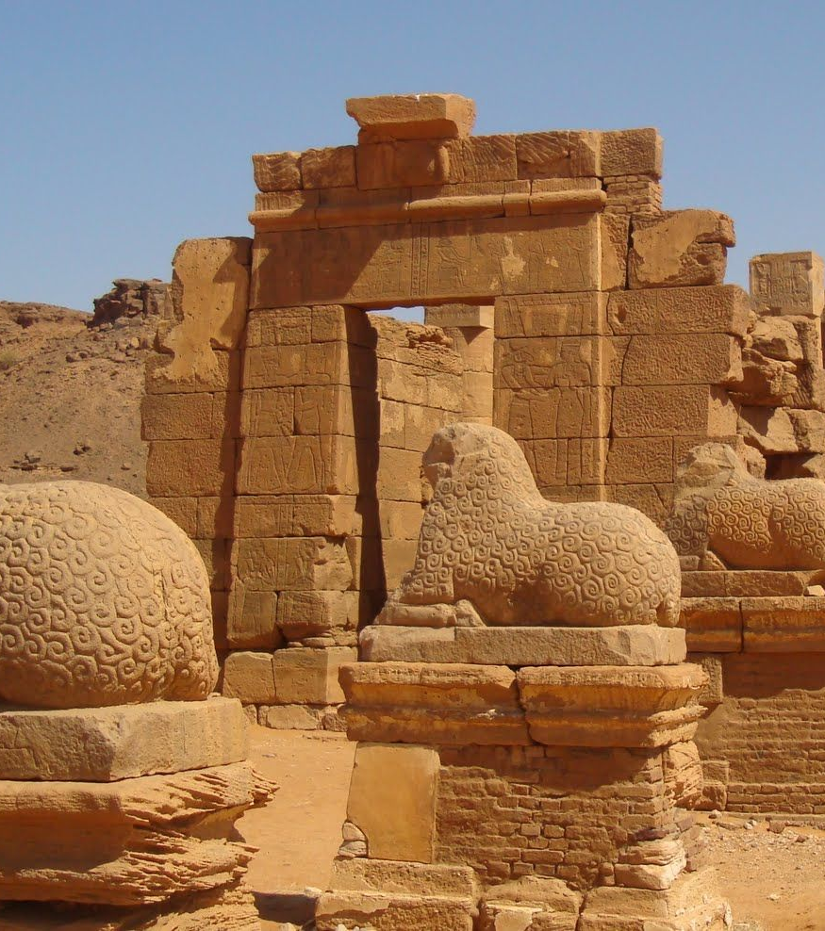
Kingdom of Kush
Historians believe the Kingdom of Kush to have been an advanced civilization with it's own unique language and script that dominated the region beginning around 1070 BC.
The Kingdom of Kush stood as a regional power in Africa for over a thousand years.
This kingdom was so powerful, it even ruled Egypt as the 25th dynasty, meaning the Monarchs of Kush were also the pharaohs of Egypt.
Kush was an economic center that operated a lucrative market in ivory, incense, iron and gold.
Notes:
Read the slide aloud for the students.

Slide 10
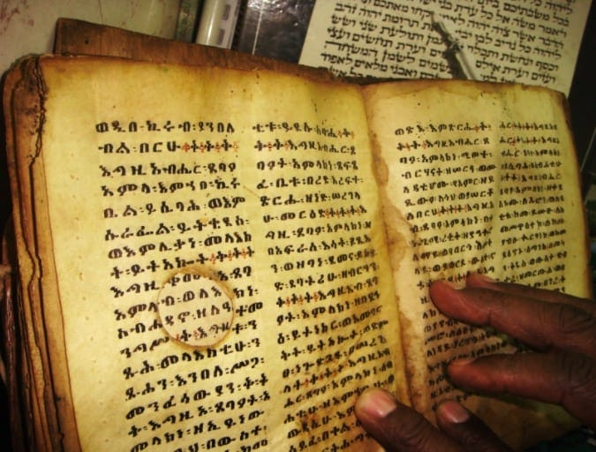
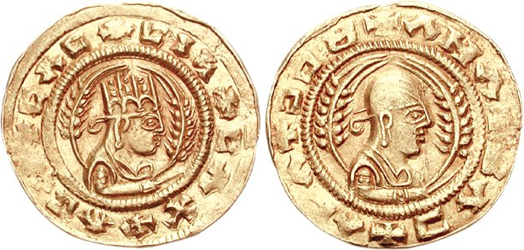
The Kingdom of Aksum (Aksumite Empire)
The Aksumite Empire existed from around 80BC to AD825, around the same time as the great Roman empire.
The Kingdom of Aksum was a trading giant whose gold and ivory created a vital link between ancient Europe and the Far East.
This kingdom had one of the first written scripts to emerge in Africa, known as Ge'ez.
The Kingdom of Aksum also had a very distinctive style of architecture that involved massive buildings, many standing over 100 feet tall.
This empire was also one of the first in Africa to issue its own coins, which simplified trade and gave prestige to the kingdom.

Slide 11
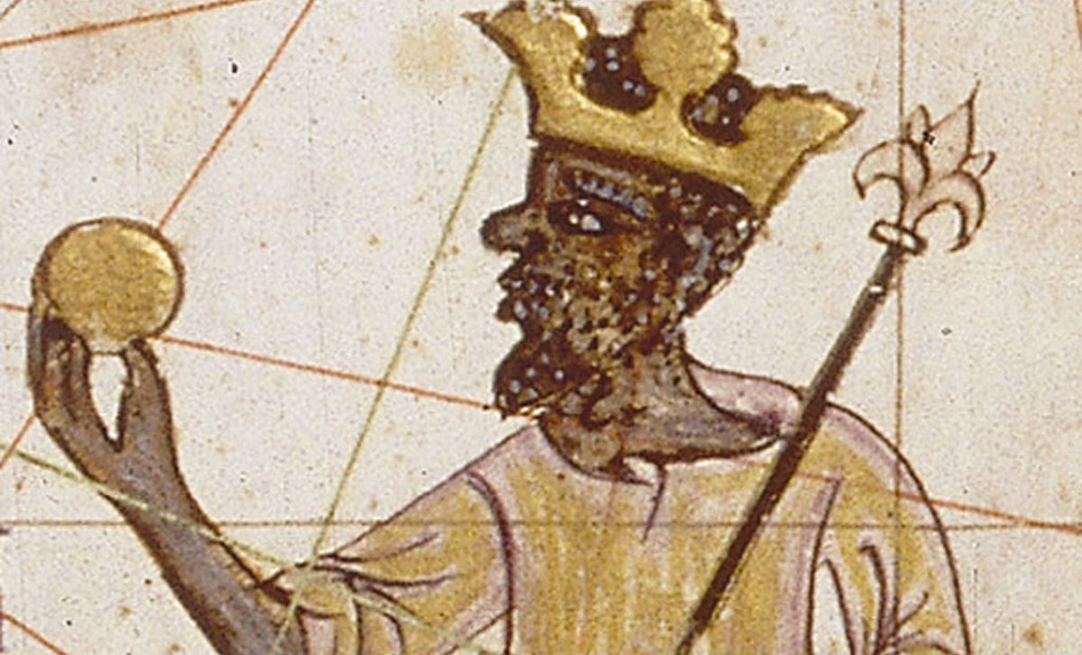
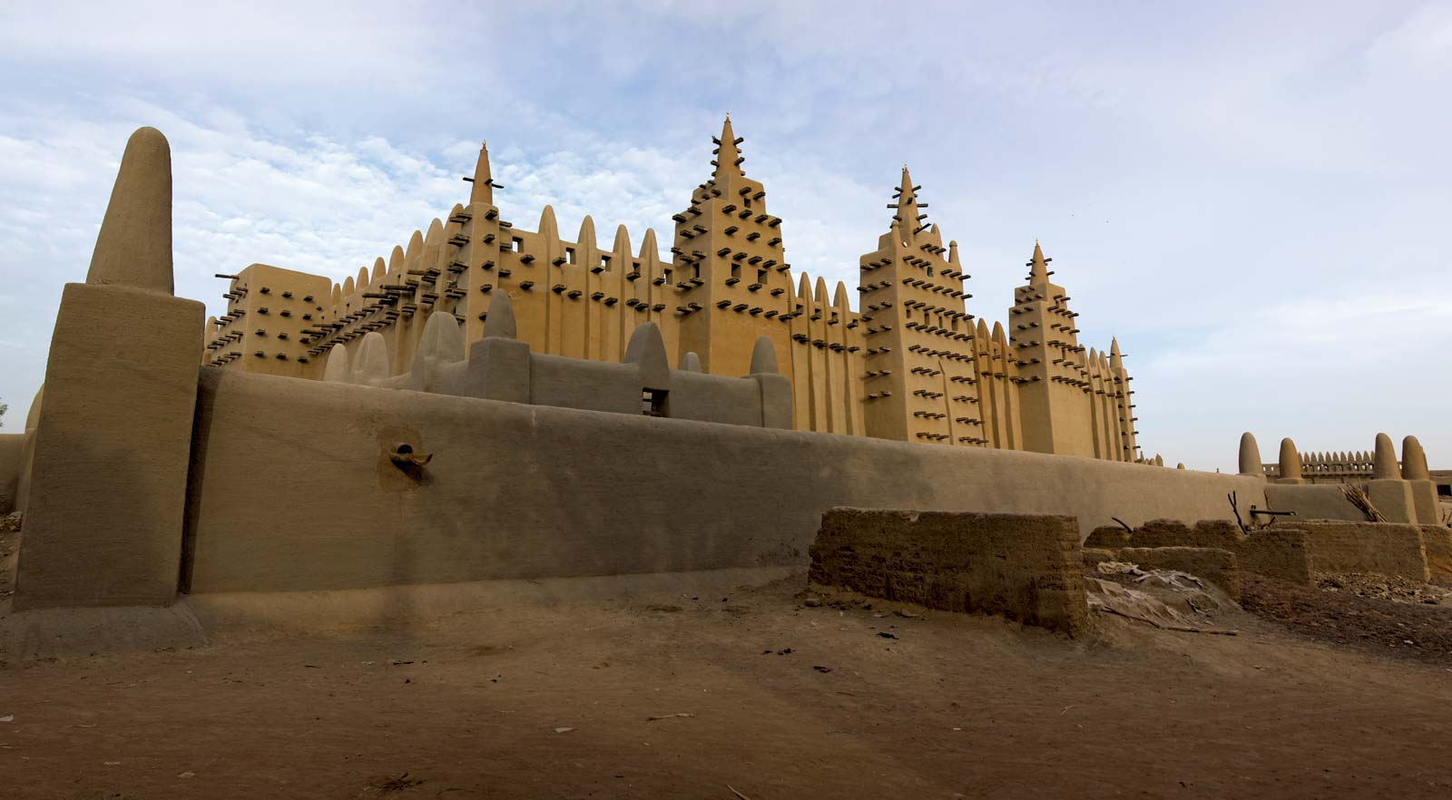
The Mali Empire
The Mali Empire dates back to the 1200s when a ruler named Sundiata Keita ("The Lion King") led a revolt and united his subjects under a new state.
The two most important cities of the Mali Empire were Djenné and Timbuktu, which were renowned for their elaborate mosques and Islamic schools.
At its peak, the Mali Empire was known the world over for its wealth and luxury.
Historians tell one story of ruler Mansa Musa traveling to Egypt and distributing so much gold that he caused the value of gold to plummet in Egyptian markets!
Notes:
Photographs: a mosque in the city of Djenné and a drawing of ruler Mansa Musa handing out gold.
Read the slide aloud for the students.

Slide 12
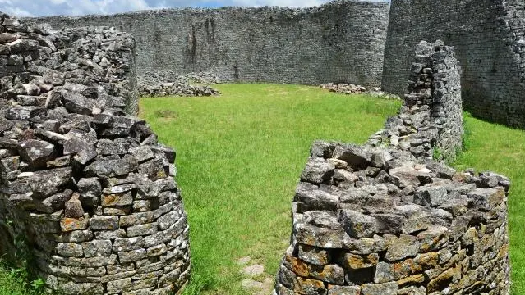
The Kingdom of Zimbabwe
The Kingdom of Zimbabwe was an indigenous empire that ruled over a large chunk of modern-day Botswana, Zimbabwe and Mozambique between the 13th and 15th centuries.
This empire was particularly rich in cattle and precious metals.
The remains of artifacts like Chinese pottery, Arabian glass and European textiles indicate that it was once a well-connected mercantile center.
In the center of the Great Zimbabwe stands one of the most impressive monuments in sub-Saharan Africa.
Notes:
Pictured: the great enclosure courtyard, Great Zimbabwe.
Read the slide aloud for the students.

Slide 13
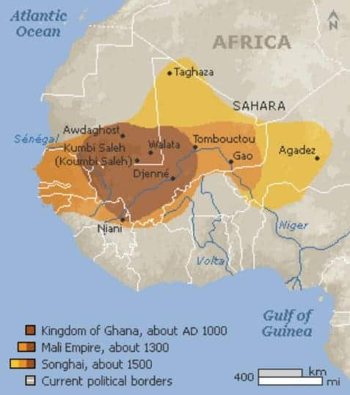
Songhai Empire
The Songhai Empire formed in the 15th century.
This West African kingdom was larger than Western Europe and comprised parts of a dozen modern day nations.
The Songhai Empire prospered largely due to vigorous trade policies and a sophisticated bureaucratic system.
The empire was divided into provinces, each ruled by its own governor.
The Songhai Empire's greatest leader was Askia the Great, who expanded the reach of the kingdom and established hundreds of schools
King Askia also advocated for learning and rewarded professors with large pensions
Notes:
This picture illustrates the reach of the Songhai Empire
Read the slide aloud for the students.

Slide 14
Reflection
Many of these kingdoms and empires existed at the same time as the Roman, Greek and Egyptian empires. All of whom you learn about in history class.
What can you do to try to get this rich African history worked into school curriculum?
Notes:
Invite the students to engage in the reflection question.

Slide 15
Check Out Which do you prefer?
Beach
Pool
Notes:
Engaeg the students in the check out question.

Slide 16
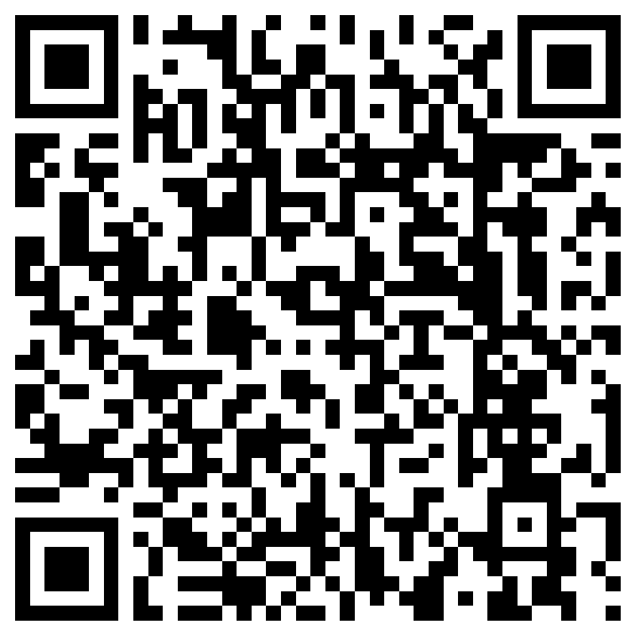
Teacher Feedback
Notes:
Teacher, please scan the QR code or click the link below to provide valuable feedback:
https://forms.office.com/r/i9UqyyxzTT

Slide 17
Human Relations, Diversity & Equity

